Slide 1
SRM INSTITUTE OF SCIENCE AND TECHNOLOGY Dept. of Computer Science and Engineering · Design and Innovation Club
NLP HACKATHON 2026
KuralAI
Expressive Tamil Audiobook Generator
TEAM · KuralAI
Sricharan Suresh RA2311003040063
Mani Shankar B RA2311003040045
Jai Vignesh K RA2311003040020

Slide 2
PROBLEM STATEMENT 3
Expressive Tamil Audiobook Generator
An intelligent Text-to-Speech system that converts Tamil stories and literature into expressive, emotion-aware audiobooks — narrated with distinct character voices and broadcast-ready audio quality.
1
Natural Speech
2
Emotion-Aware
Proper Tamil pronunciation & flow
Joy, sorrow, anger, fear, surprise
3
Character Voices
4
Commercial Quality
Distinct voice per speaker
Classical & modern literature, broadcast audio
80M+
Tamil speakers worldwide — still underserved by expressive TTS
KuralAI
02 / 08

Slide 3
PROBLEM ABSTRACT
Tamil Deserves More Than Monotone TTS
Tamil TTS today produces flat, monotone speech that strips away the emotional richness of Sangam poetry and modern fiction alike. KuralAI pairs a lightweight, rule-based emotion tagger with neural TTS to deliver narration that respects the source material's dramatic intent — without requiring GPU-heavy models.
80M+
6
0
Tamil speakers with no expressive TTS option
Emotion categories detected per segment
GPUs required — runs on any device
EXISTING TAMIL TTS
KURALAI APPROACH
Flat, monotone delivery · Single generic voice · Ignores emotional context in the text
Emotion-aware prosody · Distinct multi-character voices · Lightweight, edge-friendly pipeline
KuralAI
03 / 08

Slide 4
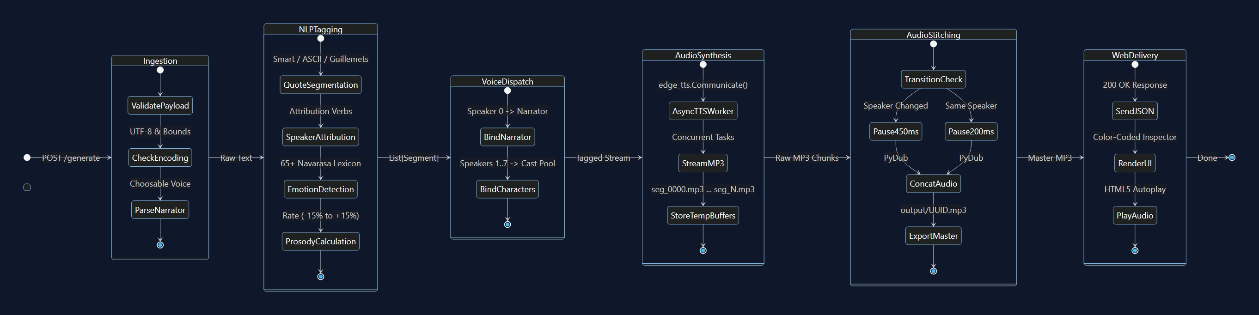
SYSTEM DESIGN · STATE MACHINE
UML State Lifecycle & Transitions
Event-driven state transitions from request ingestion and rule-based NLP tagging to multi-voice audio synthesis and streaming delivery.
Fig. 2 — UML State Machine: Ingestion → NLP Tagging → Voice Dispatch → Neural Synthesis → Delivery
KuralAI
04 / 08

Slide 5
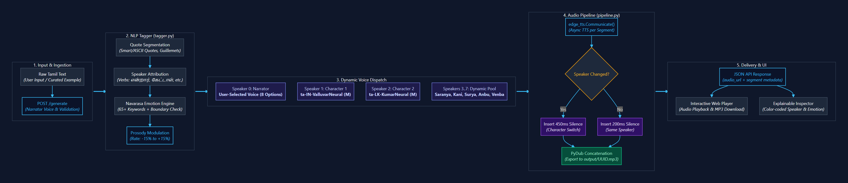
SYSTEM DESIGN · DETAILED VIEW
Pipeline Logic & Voice Dispatch
From raw text ingestion through speaker attribution, emotion tagging, voice dispatch, and silence-aware audio stitching to final delivery.
Fig. 3 — Detailed pipeline logic: ingestion → tagging → voice dispatch → stitched audio → delivery
KuralAI
05 / 08

Slide 6
WORKING PROTOTYPE · ROUND 2
From Text to Expressive Audiobook, Live
Demo Features
Tech Stack
1
8 Regional Neural Voices with choosable narrator (India, Sri Lanka, Malaysia, Singapore)
Frontend
HTML5 / Vanilla CSS / JS (with offline static fallback)
2
Navarasa Emotion Engine (65+ keywords & punctuation rate modulation)
Backend
Python 3.12 (Flask backend + REST API)
NLP
Rule-based regex NLP (Zero GPU, zero latency, 100% explainable)
3
Regex Dialogue Segmentation & heuristic multi-character attribution
TTS
Microsoft Edge TTS — 8 neural voices across 4 regions, free & zero API key
4
Silence-aware audio stitching (450ms dialogue / 200ms narration pauses)
Audio
PyDub + FFmpeg — dynamic silence insertion & broadcast MP3 export
Browser UI
Flask Backend
NLP + Emotion Tag
edge-tts Synthesis
Audio Output
KuralAI
06 / 08

Slide 7
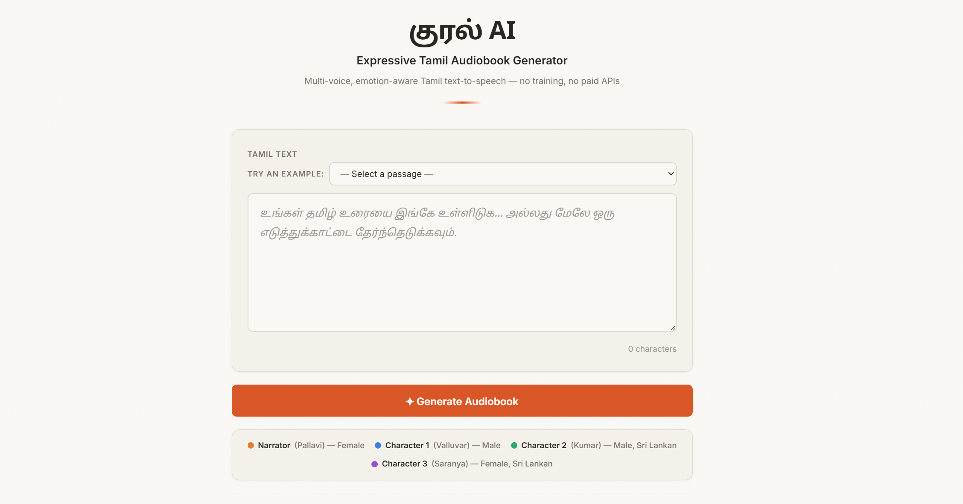
LIVE DEMO
Try It Yourself
The prototype is live — paste Tamil text or pick a sample passage and generate a multi-voice audiobook in the browser.
verycareful.github.io/KuralAI
Live prototype: verycareful.github.io/KuralAI
KuralAI
07 / 08

Slide 8
Thank You
KuralAI · Expressive Tamil Audiobook Generator
Sricharan Suresh · Mani Shankar B · Jai Vignesh B

